Slide 1
Following Malware Execution in IDA or Ghidra

Slide 2
Following Malware Execution
The Ghidra decompilation view and control flow graphs are very useful for analyzing the malware’s possible execution paths
  Function calls, loops, if statements, etc.
But execution can change in ways other than jumps and calls
Often need to find out how the malware is executing different areas of code

Slide 3
DLLs

Slide 4
DLL review
Dynamic Link Library
Exports functions for other executables to use
Advantage: can be shared among running processes, saving memory

Slide 5
How Malware Uses DLLs
By storing malicious code
  May export functions to other malware files
  May be loaded into another process
By using Windows DLLs
  To interact with the operating system via Windows API functions
By using third-party DLLs
  To interact with other non-Windows programs
  To use a library that may not be on the victim’s machine

Slide 6
Analyzing DLLs
DLLs have many points from which code can be executed
  Each exported function
  DllMain
DllMain is called whenever a process loads or unloads the DLL
  Normally used for managing any resources specific to a process, but malware sometimes uses it for other purposes

Slide 7
Processes

Slide 8
Process Review
Process – program in execution
Used to keep programs from interfering with each other
  Each process has a separate address space (whereas threads share address space)
  OS manages how processes access shared resources (CPU,RAM, filesystem, hardware, etc)

Slide 9
Creating a Process
The CreateProcess function is typically used to create a process
Has many parameters, gives caller a large amount of control over how the process is created
  How many parameters? See here

Slide 10
Running an Embedded Executable
Malware contains an executable as a resource
Uses FindResource, LoadResource, CreateFile, etc to write resource to disk
Uses CreateProcess to run the resource

Slide 11
Creating a Remote Shell
Remote shell – allows an attacker to run commands on the victim’s computer remotely
Can create a remote shell by opening a socket and using a single call to CreateProcess!

Slide 12
Creating a Remote Shell
Need to pass specific arguments to CreateProcess
  The lpStartupInfo parameter points to a STARTUPINFO struct
  This struct contains handles to stdin, stdout, and stderr
  Point stdin, stdout, and stderr to the socket
  Call CreateProcess
All input from the malware actor over the socket is run on the command line

Slide 13
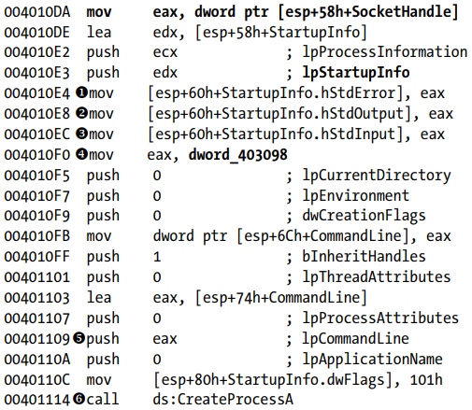
Creating a Remote Shell – Sample Code
Practical Malware Analysis pg 148

Slide 14
Process Injection
Malware can inject its own code into a different process
Typically performed using the VirtualAlloc, WriteProcessMemory, and CreateRemoteThread API calls
Will cover this and other covert launching techniques later

Slide 15
Threads

Slide 16
Thread Review
Thread – sequence of instructions belonging to a process that is executed by the CPU
Each process contains one or more threads
  All threads share the process’s memory space
  Each thread has its own values for registers and the stack
    Storing and restoring these is the substance of a “context switch”

Slide 17
Creating a Thread
Done using the CreateThread function
  Takes lpStartAddress, a pointer to a function
  Also takes lpParameter, a single parameter to the function
  The thread executes the function until it returns

Slide 18
Covertly Loading a Malicious Library
Can use CreateThread to covertly load a malicious library into a process
Need to set certain parameters to CreateThread
  Pass the address of the LoadLibrary Windows API function as the lpStartAddress parameter
  Pass the name of the desired library as lpParameter
Even more stealthy if “LoadLibrary” and the name of the library are obfuscated – which is easy to do

Slide 19
Services

Slide 20
Services Review
Service – a task that runs in the background without an associated process or thread or user
Managed by the Windows Service Manager

Slide 21
Why Malware Uses Services
Can be set to automatically run when the computer boots
  Gives persistence
Often run with SYSTEM privileges
  But need admin to specify this

Slide 22
Creating / Starting a Service
OpenSCManager – Returns a handle to the service control manager, which is needed for all other service-related API calls
CreateService – Adds a new service to the service control manager
  Can specify that the service automatically runs at boot
StartService – Starts a service manually

Slide 23
Types of Services
WIN32_SHARE_PROCESS – Stores code for a service in a DLL, run by svchost.exe
WIN32_OWN_PROCESS – Stores code in an EXE, runs as an independent process
KERNEL_DRIVER – Used for loading code into the kernel

Slide 24
Exceptions

Slide 25
Exceptions Review
Exception – allows a program to handle events outside its normal execution path
Can be triggered by:
  Errors (such as a divide by 0)
  Hardware (such as invalid memory access)
  Manual call to RaiseException

Slide 26
Structured Exception Handling
Structured Exception Handling (SEH) – Windows mechanism for handling exceptions
  List of functions for handling exceptions
  Each function can handle the exception or pass it to the next handler
  If an exception makes it to the end of the list without being handled, it is considered an unhandled exception and crashes the process

Slide 27
How Malware Uses Exceptions
The SEH is a type of flow control that can’t be followed by disassemblers and can fool debuggers
Malware can add its own custom exception handler to the SEH and then use trigger an exception to transfer execution to the handler

